Slide 1
2.5 Representing Instructions in Computer
Instructions are encoded in binary
Called machine code
MIPS instructions
Encoded as 32-bit instruction words
§2.5 Representing Instructions in the Computer

Slide 2
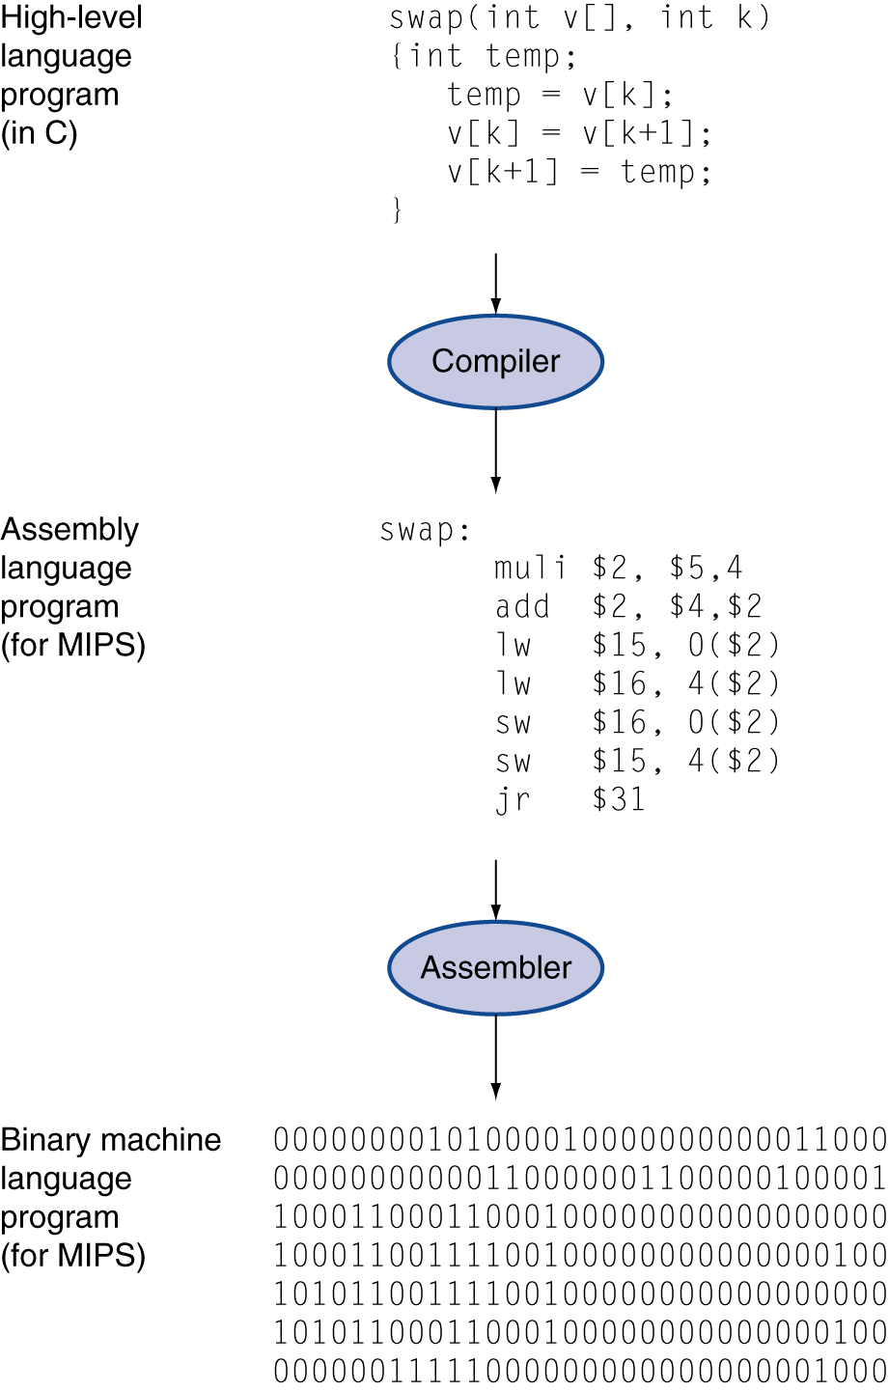
Representation of a Program
High-level language
Level of abstraction closer to problem domain
Provides for productivity and portability
Assembly language
Textual representation of instructions
Hardware representation
Binary digits (bits)
Encoded instructions and data

Slide 3
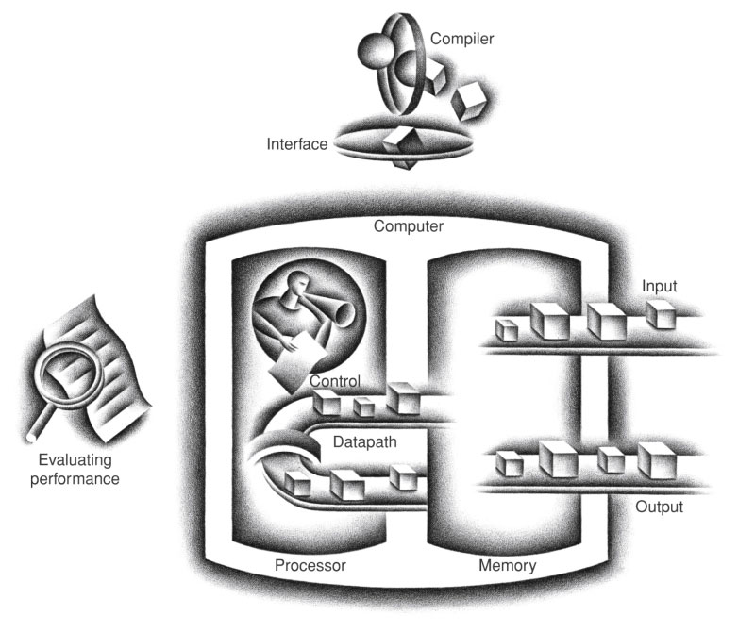
17번 방의 값과
18번 방의 값을
더해서 8번 방에 써라.
00000010001100100100000000100000₂
FIGURE 1.5 The organization of a computer, showing the five classic components. The processor gets instructions and data from memory. Input writes data to memory, and output reads data from memory. Control sends the signals that determine the operations of the datapath, memory, input, and output.
Copyright © 2014 Elsevier Inc. All rights reserved.

Slide 4
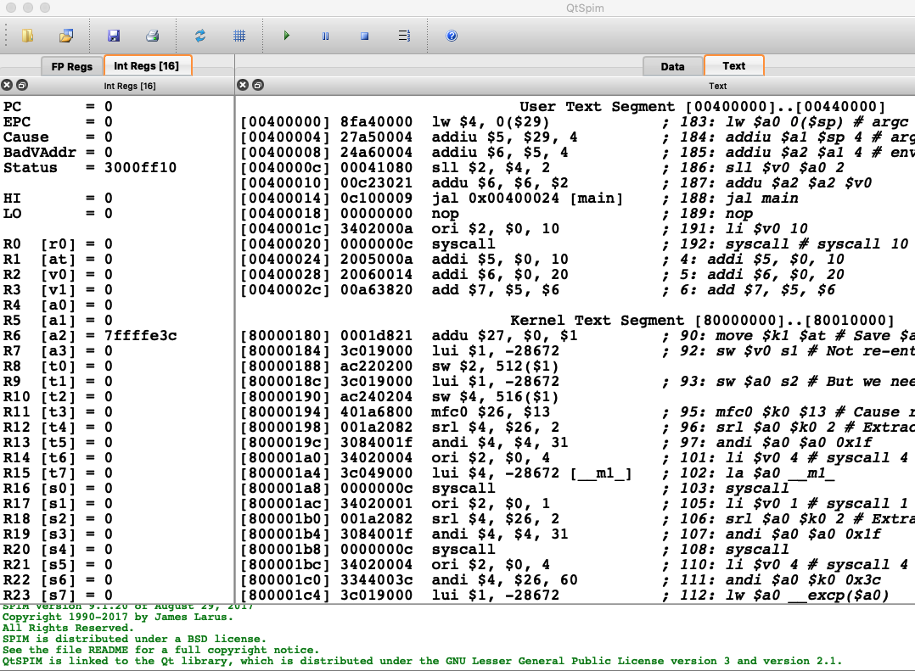
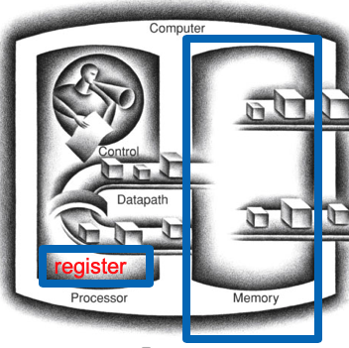

Slide 5
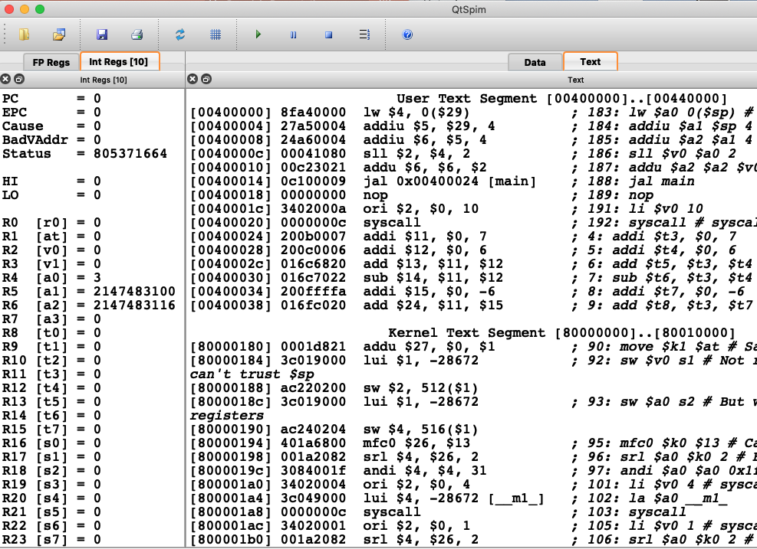

Slide 6
MIPS R-format Instructions
op
rs
rt
rd
shamt
funct
6 bits
5 bits
5 bits
5 bits
5 bits
6 bits
Instruction fields
op: operation code (opcode)
rs: first source register number
rt: second source register number
rd: destination register number
shamt: shift amount (00000 for now)
funct: function code (extends opcode)

Slide 7
R-format Example : add
op
rs
rt
rd
shamt
funct
6 bits
5 bits
5 bits
5 bits
5 bits
6 bits
add $t0, $s1, $s2
special
$s1
$s2
$t0
0
add
0
17
18
8
0
32
000000
10001
10010
01000
00000
100000
00000010001100100100000000100000₂ = 02324020₁₆

Slide 8
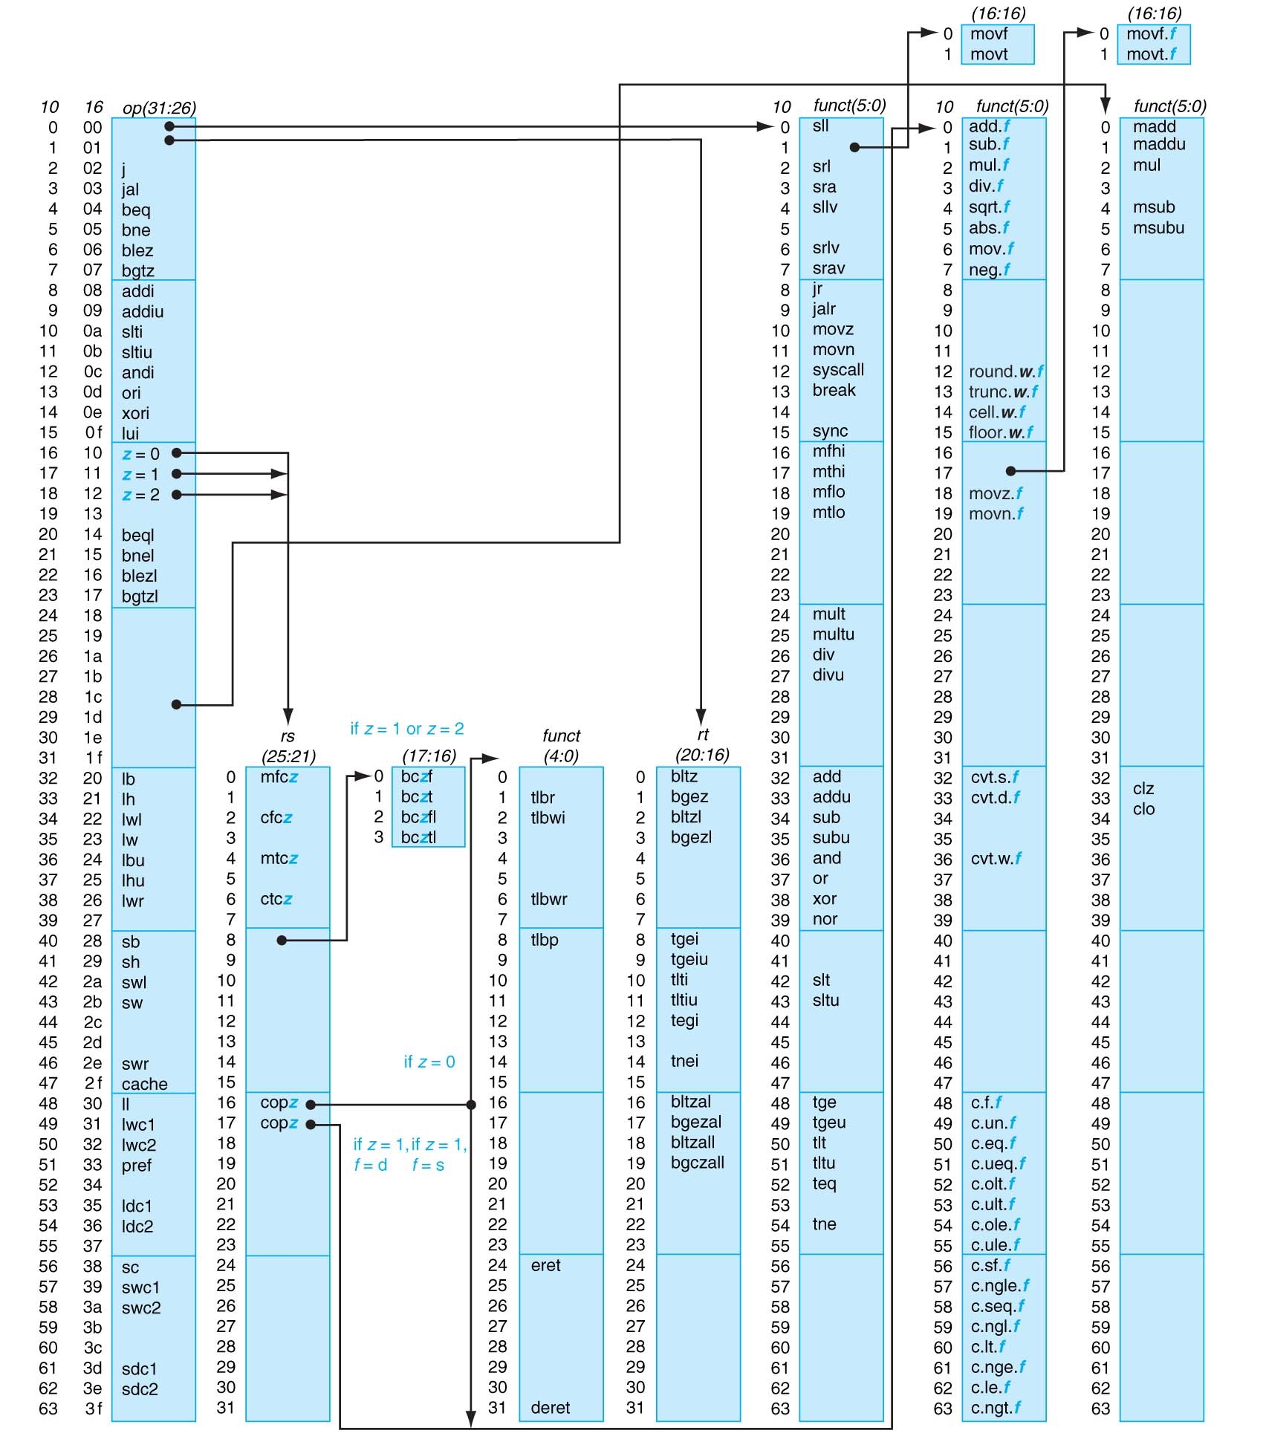
MIPS opcode map
Appendix A-50

Slide 9
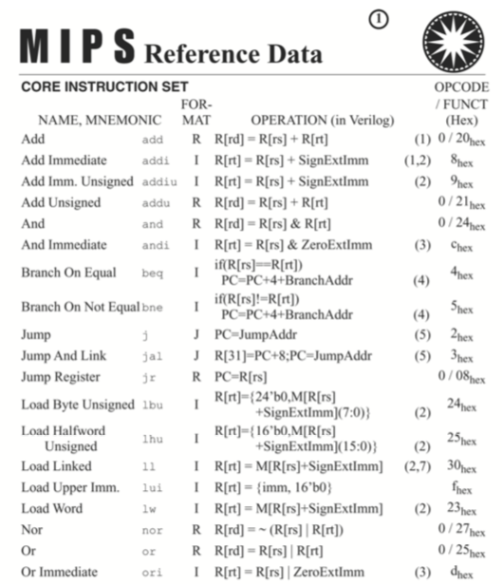

Slide 10
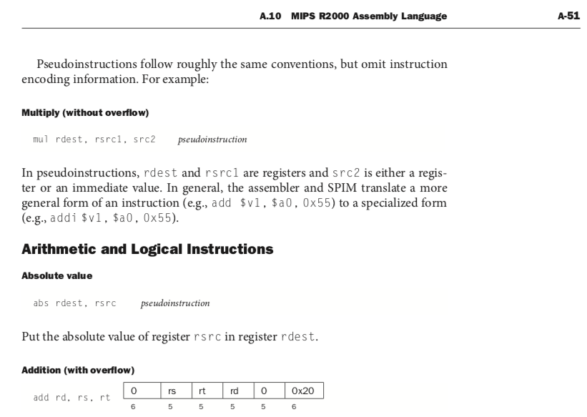

Slide 11
Disassemble the following MIPS instruction
0x00853022
= 0000 0000 1000 0101 0011 0000 0010 0010
= 000000 00100 00101 00110 00000 100010
000000 00100 00101 00110 00000 100010 op rs rt rd shamt funct
= sub $6, $4, $5
Notes:
Board work: Binary Numbers

Slide 12
MIPS opcode map
Appendix A-50

Slide 13
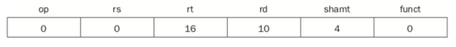
R-format instructions
add / addu
sub / subu
or / and / nor
sll / srl
sll $10, $16, 4
000000 00000 10000 01010 00100 000000
0000 0000 0001 0000 0101 0001 0000 0000
= 0x00105100

Slide 14
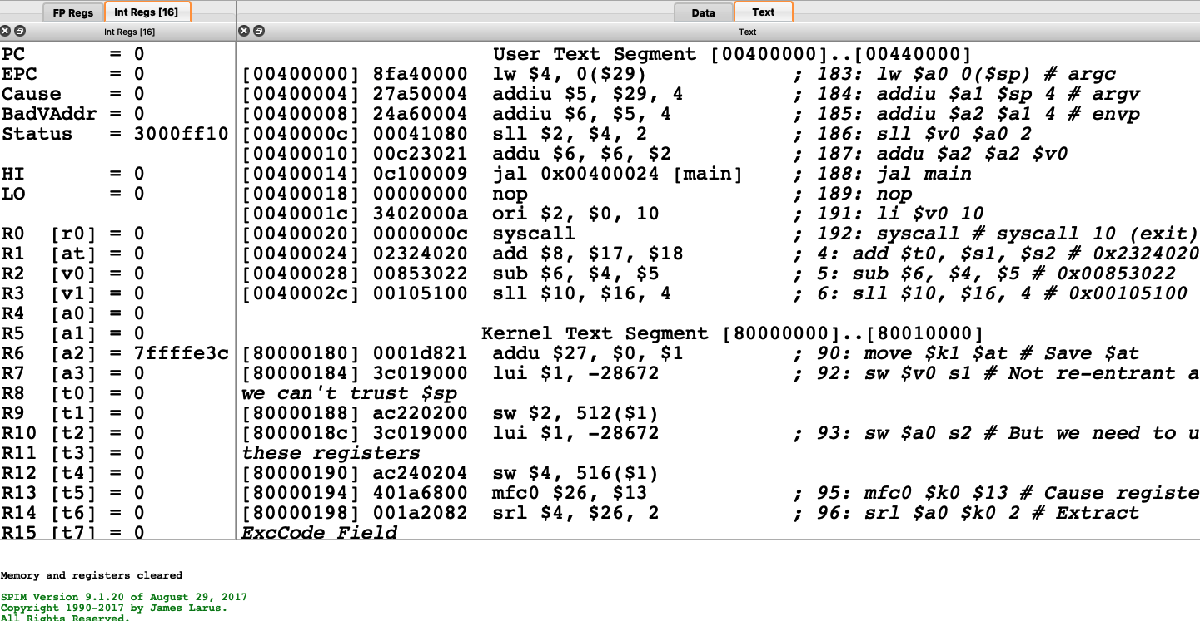

Slide 16
0x016C6820
= 0000 0001 0110 1100 0110 1000 0010 0000
000000 01011 01100 01101 00000 100000
add $13, $11, $12

Slide 17
MIPS I-format Instructions
op
rs
rt
constant or address
6 bits
5 bits
5 bits
16 bits
Immediate arithmetic and load/store instructions
rt: destination or source register number
Constant: –2¹⁵ ~ (+2¹⁵ – 1)
ori, andi (no sign extension)
addi (sign extension)

Slide 18
ori
op
rs
rt
constant or address
6 bits
5 bits
5 bits
16 bits
ori $11, $9, 0
001101 01001 01011 0000000000000000
0011 0101 0010 1011 0000 0000 0000 0000
= 0x352B0000

Slide 19
MIPS opcode map
Appendix A-50

Slide 20
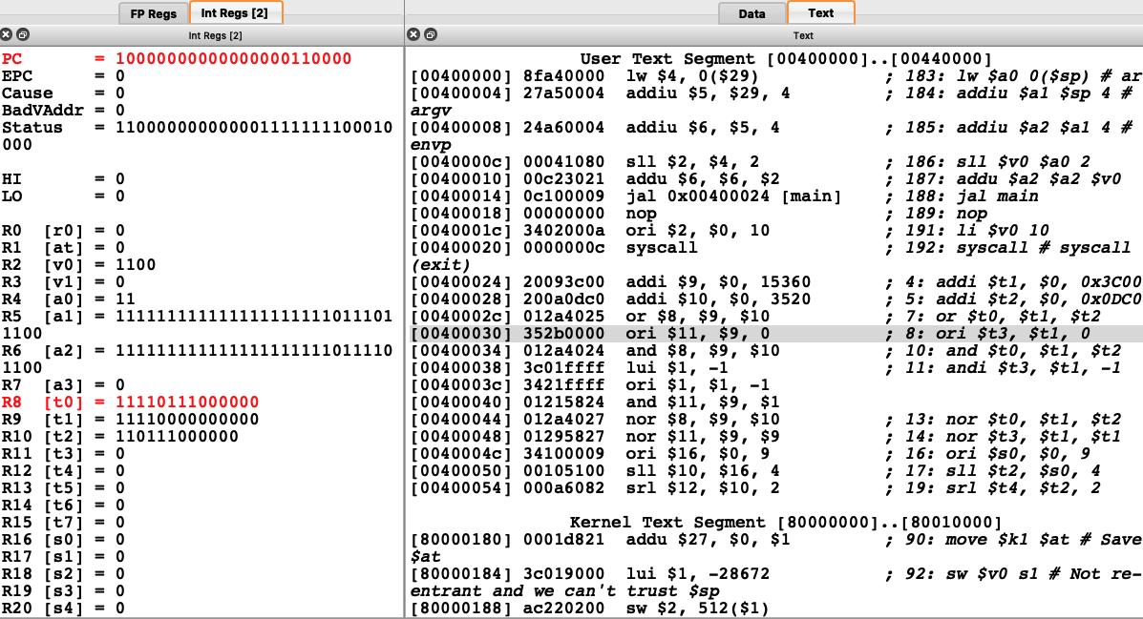

Slide 21
andi $11, $0, 0xffff
명령어가 메모리에 저장된 내용
001100 00000 01011 1111111111111111
→ 0011 0000 0000 1011 1111 1111 1111 1111
= 0x300BFFFF
$0 : 0000 0000 0000 0000 0000 0000 0000 0000
and ???? ???? ???? ???? 1111 1111 1111 1111
$11: 0000 0000 0000 0000 0000 0000 0000 0000
? = 0
프로세서가 수행하는 연산

Slide 22
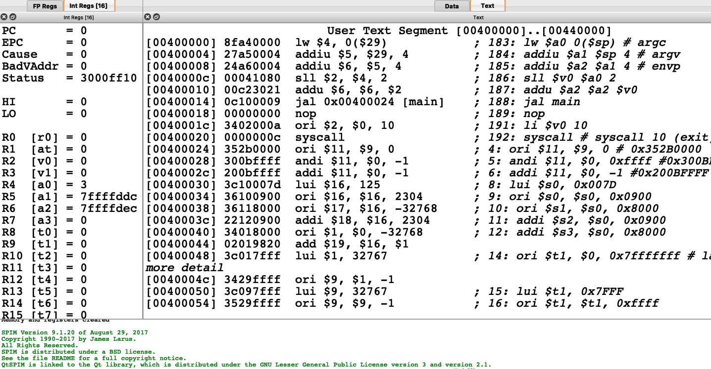

Slide 23
MIPS opcode map
Appendix A-50

Slide 24
addi $11, $0, -1
명령어가 메모리에 저장된 내용
001000 00000 01011 1111111111111111
→ 0010 0000 0000 1011 1111 1111 1111 1111
= 0x200BFFFF
$0 : 0000 0000 0000 0000 0000 0000 0000 0000
+ ???? ???? ???? ???? 1111 1111 1111 1111
$11: 1111 1111 1111 1111 1111 1111 1111 1111
sign extension
? = 1
프로세서가 수행하는 연산

Slide 25
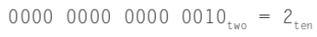
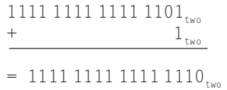
Sign Extension (section 2.4)
16-bit -2 를 32-bit -2 로 extend 할 때
← -2 in 16-bit
???? ???? ???? ????
-2 in 32-bit
* 0000 0000 0000 0000 1111 1111 1111 1110 = +65534

Slide 26
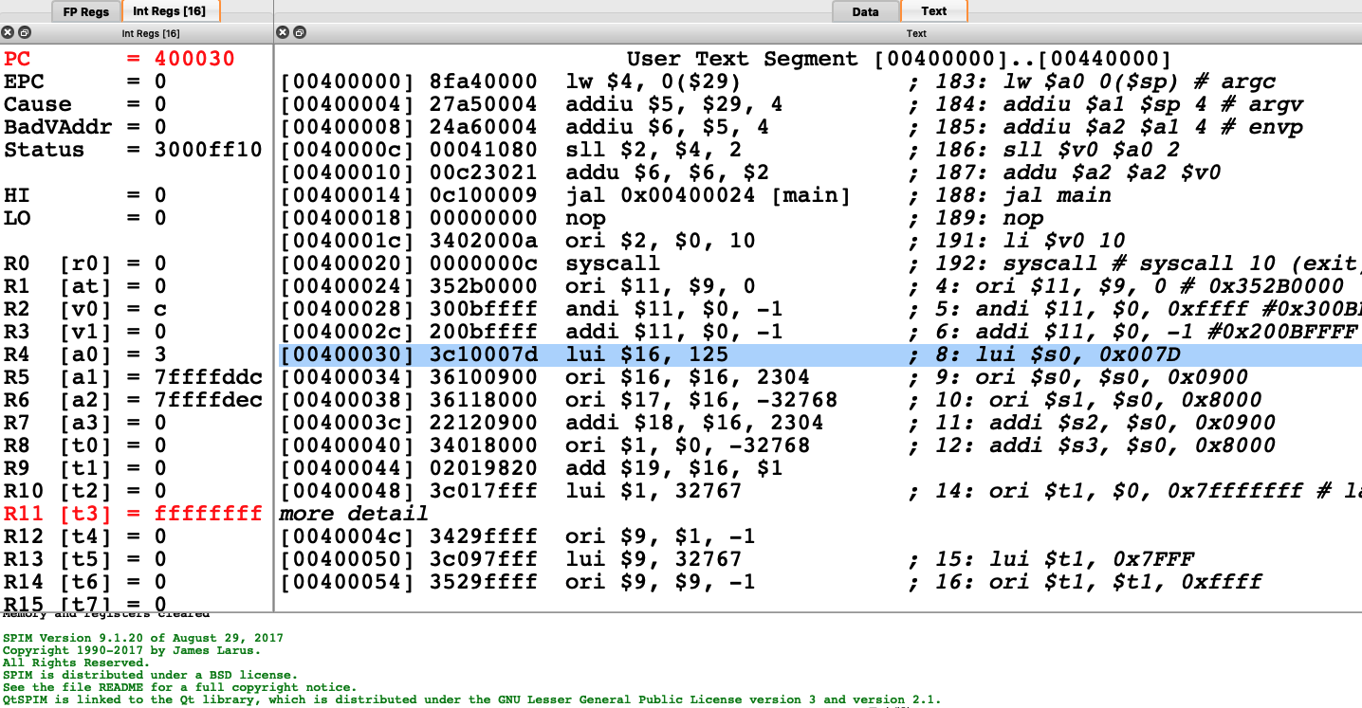

Slide 27
logical operation 은 sign extension 을 하지 않는다.
logical operation 의 operand 는 숫자가 아니라 bit pattern 으로 보기 때문
(그런데 spim simulator 의 assembler 는
16진수로 쓴 상수는 항상 sign extension 을 하지 않고
signed number 로 쓰인 10진수는 sign extension 을 한다. )

Slide 28
How to store a 16-bit value to a register
addi $10, $zero, 1
li $10, 1 # load immediate instruction : pseudoinstruction
pseudoinstruction : 기계어 명령어는 아닌데 assembly 명령어만 있는 명령어 (프로그래머의 편의를 위해 존재)

Slide 29
2.10 How to store a 32-bit Constant to a register
$s0 의 값을 0000 0000 0111 1101 0000 1001 0000 0000 로 만들고 싶을 때
lui rt, constant
Copies 16-bit constant to left 16 bits of rt
Clears right 16 bits of rt to 0
§2.10 MIPS Addressing for 32-Bit Immediates and Addresses
$s0
lui $s0, 0x007D
0000 0000 0111 1101 0000 0000 0000 0000
ori $s0,$s0,0x0900
???? ???? ???? ???? 0000 1001 0000 0000
?=0
A or 0 = A
프로세서가 수행하는 연산
$s0
after execution
0000 0000 0111 1101 0000 1001 0000 0000

Slide 30
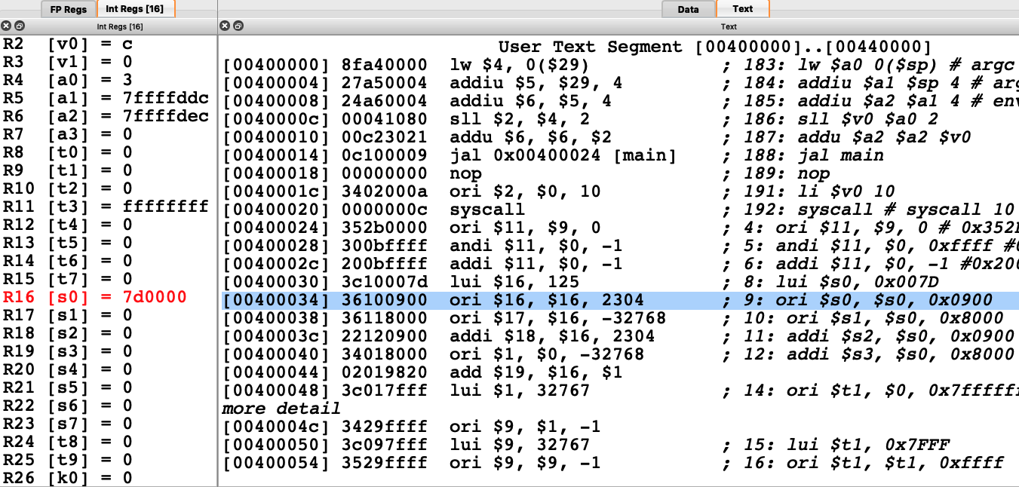

Slide 31
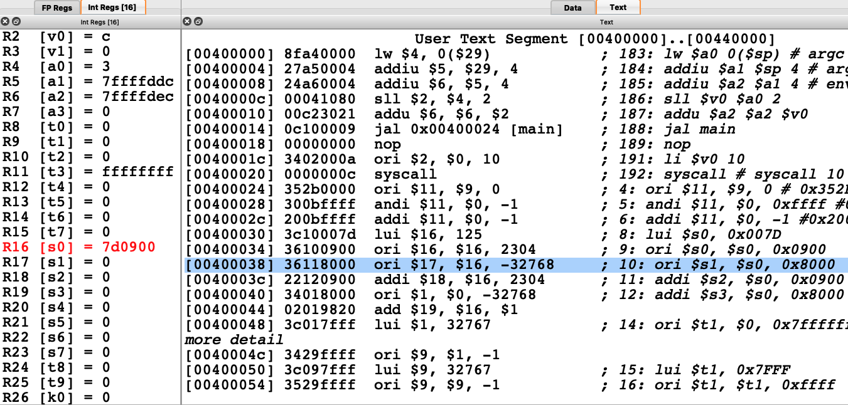

Slide 32
$t0 의 값을 0000 0000 1111 1111 0000 0000 0000 1111 로
= 0011 1100 0000 1000 0000 0000 1111 1111 = 0x3C0800FF
after executing lui $t0, 0x00FF
after executing ori $t0, $t0, 15
filled with zeros
$t0
0000000011111111
0000000000000000
old $t0
0000000011111111
0000000000000000
0000000000000000
0000000000001111
ori
$t0
0000000011111111
0000000000001111

Slide 33
MIPS opcode map
Appendix A-50

Slide 34
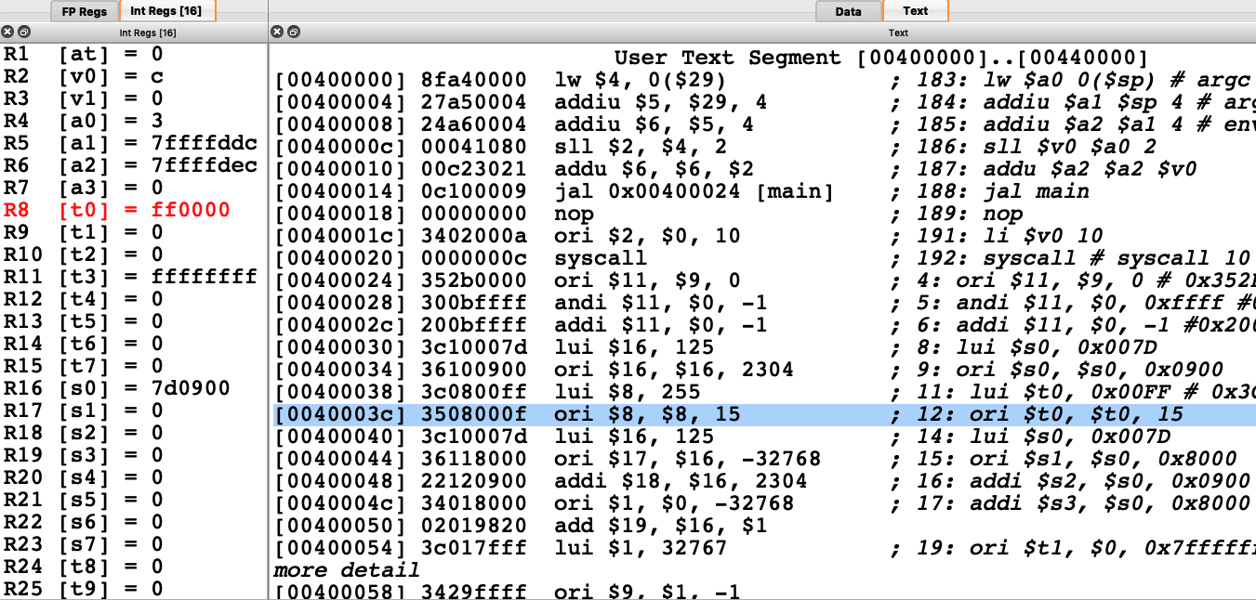

Slide 35


Slide 36
유사명령어 addi $t1, $0, 0x7fffffff
.text
.globl main
main:
addi $t1, $0, 0x7fffffff
lui $t2, 0x7fff
ori $t2, $t2, 0xffff

Slide 37
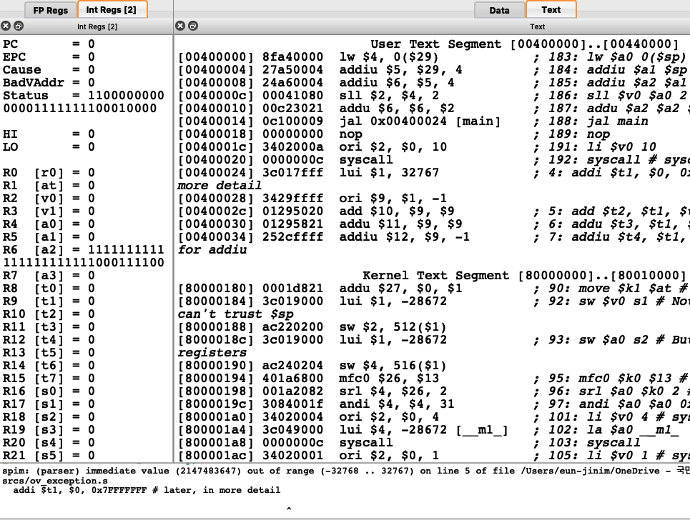

Slide 38
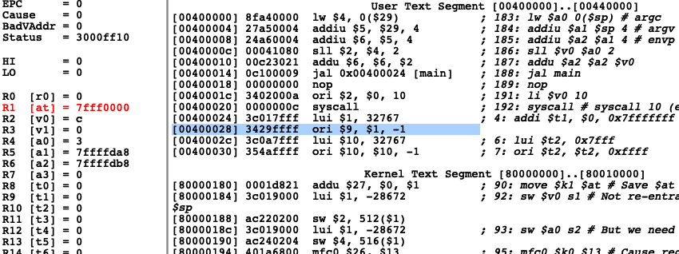

Slide 39
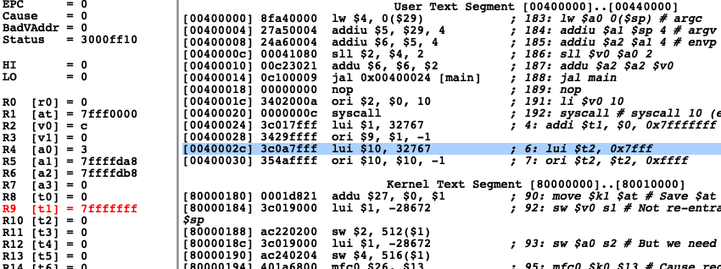

Slide 40
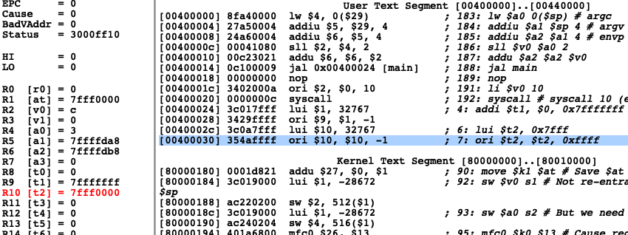

Slide 41
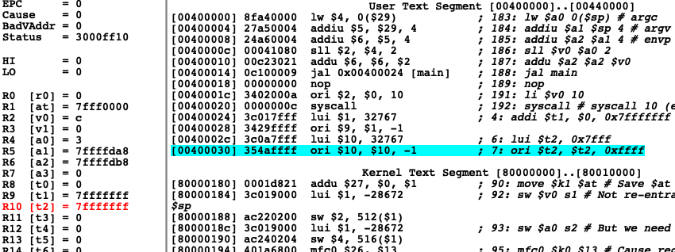

Slide 42
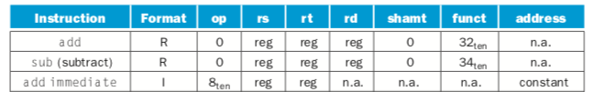
R and I format instructions

Slide 43
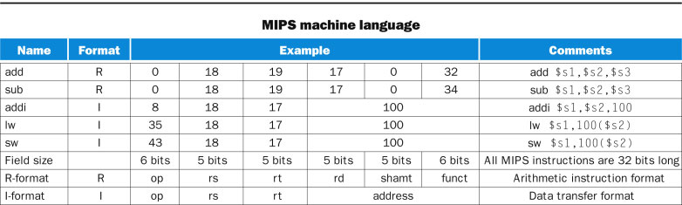
FIGURE 2.6 MIPS architecture revealed through Section 2.5. The two MIPS instruction formats so far are R and I. The first 16 bits are the same: both contain an op field, giving the base operation; an rs field, giving one of the sources; and the rt field, which specifies the other source operand, except for load word, where it specifies the destination register. R-format divides the last 16 bits into an rd field, specifying the destination register; the shamt field, which Section 2.6 explains; and the funct field, which specifies the specific operation of R-format instructions. I-format combines the last 16 bits into a single address field.
Copyright © 2014 Elsevier Inc. All rights reserved.

